Slide 1
Data Storyline final Project
Shmuel Naaman

Slide 2
Types of Biases: Data Collection
● Selection and Response Bias: Since we did not collected the data we are not aware about the Selection and Response Bias. ● Missing Variables: We did not examine all the variables in the data as part of the analysis. ● Survivorship Bias: Analysis is done on each genre separately and only for movies with budget higher than 1M$ and revenue higher than 0. To choose the top 10% company we used only the last year.
Notes:
Types of Biases: Important to point out the fact that We did not examine all the variables. However the important variables were explored, we also performed preliminary analysis to some of the variables and we can provide that soon as the analysis is done.
Important: The reason to choose the “budget higher than 1M$ “ is to filter out student movies and very low budget movies that are not expected to provide high income on average. We focus the analysis on reducing risks for high budget movies.

Slide 3
Types of Biases: Data Processing
● Outliers: For this dataset we did not treated outliers since these might include important information. On the other hand, we did not include movies with very low budget or revenue in the analysis. ● Distribution: Understanding: revenue/budget ration is not normally distributed. Samples count are not evenly distributed for different genres (1-2400 samples) and movie companies(4-900 samples). This is also correct for months but much less (700-1400 samples). ● Missingness: Understanding: Rows with missing values and nulls were removed.
Notes:
Important: Because we are looking for success and also looking for variation from the average it is important to include the high revenue/budget ratio outliers. Since the data set was large enough we could remove rows with missing values whenever the missing values are important for the analysis. Further analysis might consider more elegant way to handle outleirs

Slide 4
Types of Biases: Data Insights
● Overfitting/Underfitting: looking at the top 10%. The data include extreme outliers that might affect the results of the statistical test. ● Confounding Variables: The analysis using the revenue/budget ratio, That obscure some insight because we are not aware to the total revenue or budget of the movie.
Notes:
Further analysis will consider also the revenue and the budget separately as another indicator to identify high revenue/budget ratio,

Slide 5
Population expectations versus the Sample data.
Considering the above, we designed the analysis to addresses insight about movies with budget larger than 1M$.
The definition of the top companies was based on the top 10% revenue/budget in the last 1 year.
Most of the analysis include only the last 5 years. For the hot season and the runtime analysis we compare the result to the previous 5 years.
This issues are important when considering the results since they are not representing the dataset population.
Notes:
Important: The analysis is specific and was designed to address specific section of the population within the dataset. The main consideration was to address the company avenue of investing in high budget movies. We also wanted to choose top companies based on the last year. We think that this is important becouse companies changes faster.

Slide 6
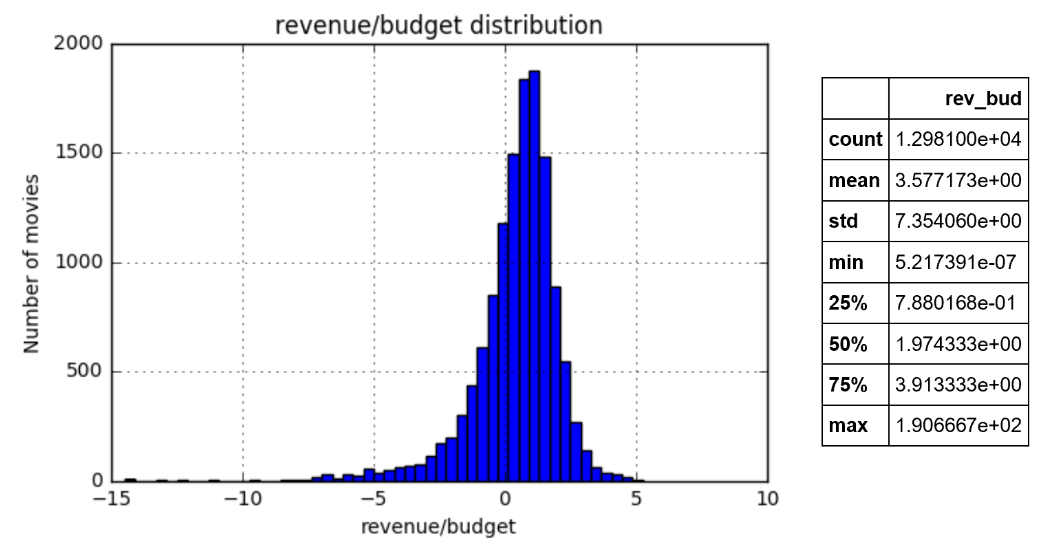
variable’s distribution Revenue/Budget
Revenue/Budget
Distribution for the top 10%. Please note the non normality of the values. We are using log scale on the x-axis. The summary statistics show extreme outliers.
Median +1.5*IQR~ 7
Notes:
Important Note that the distribution of the population was similar in shape.
Also note that the Revenue/Budget ratio for most movies is positive.

Slide 7
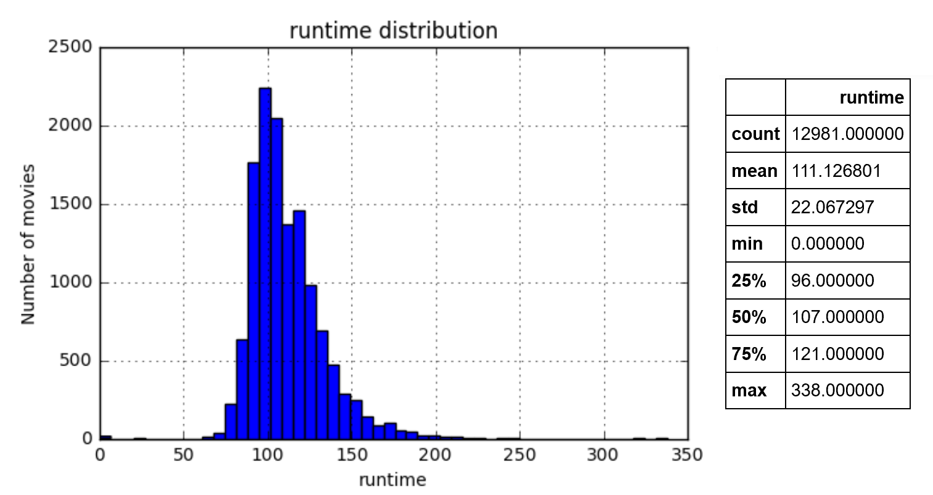
variable’s distribution Runtime
Runtime
Distribution for the top 10%. The distribution is less skewed here. The summary statistics show also less extreme outliers.
Median +1.5*IQR~ 144
Notes:
The run time distribution is quite narrow.

Slide 8
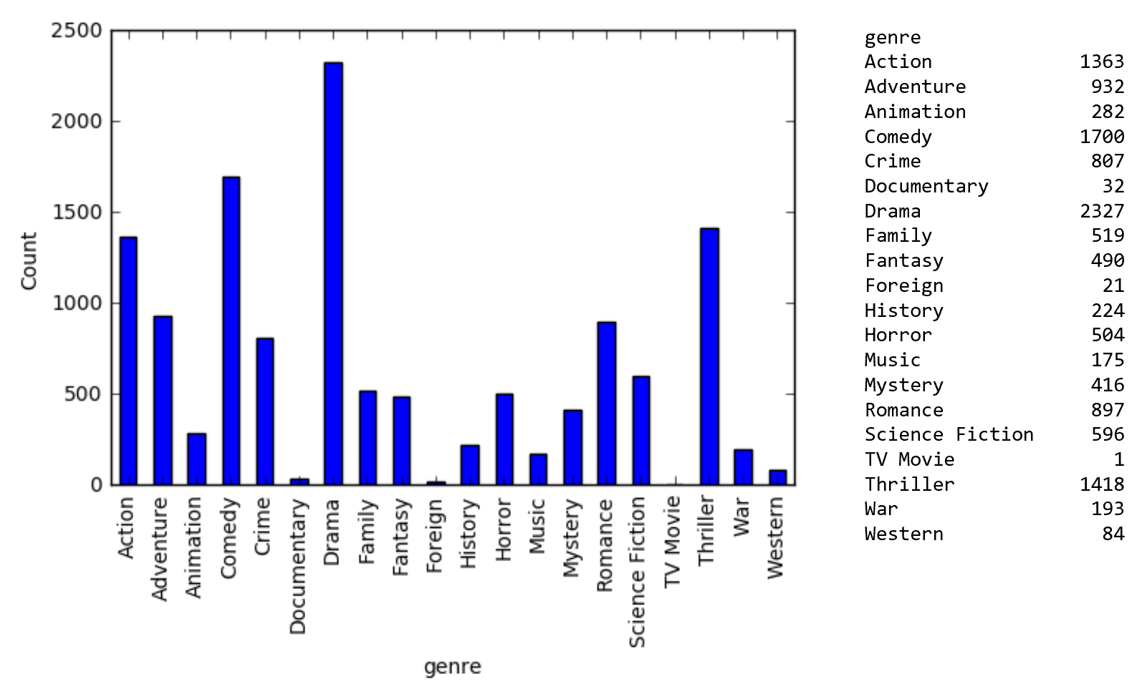
variable’s distribution Genre
Genre
Count Distribution for the top 10%. From this data we can clearly see the non even distribution between different genre. Where Drama have the largest number of samples (2327) and TV movie have the smaller number of samples(1)
Notes:
Drama Comedy and thrillers have the highest count in the top 10%. This was also the result for the entire population. So it is not a surprise. Since most produced movies are in these genres.

Slide 9
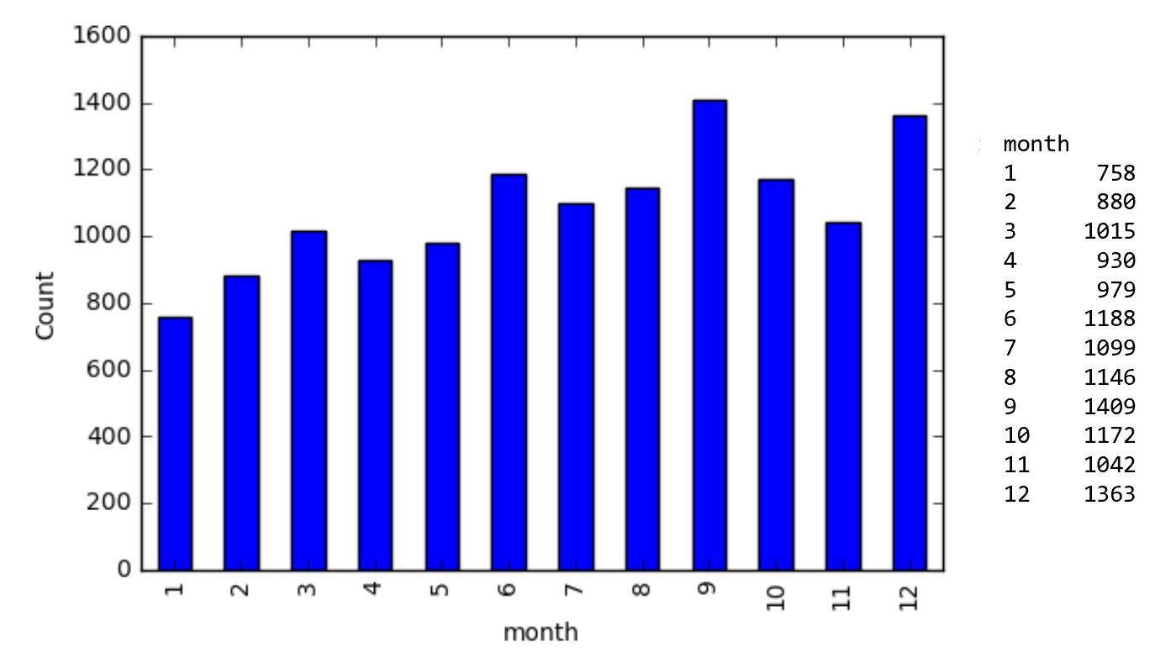
variable’s distribution Month
Month
Count Distribution for the top 10%. From this figure it is obvius that the monthly count distribution is more even. Where September have the largest number of samples (1409) and January have the smaller number of samples(758)

Slide 10
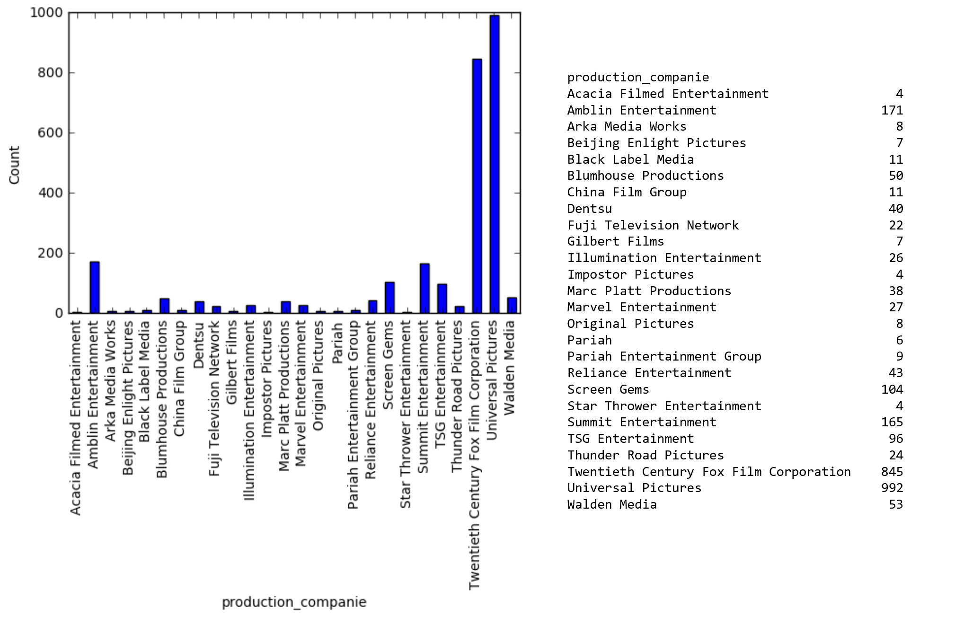
variable’s distribution Companies
Companies
Count Distribution for the top 10%. We can clearly see that only 2 companies dominate the top company list. This 2 companies produce ~1000 movies each, while the other companies in the list produce less than 200 movies.
Notes:
Universal pictures and twentieth century !!!

Slide 11
Overview of analysis, Issue Tree:
Comment : Analysis is done on each genre separately and only for movies with budget higher than 1M$ and revenue higher than 0
Top Production Companies In the last year.
Top Runtime in the last 5 years
Top Release Date in the last 5 years
Hypothesis : production company that produce the top 10% revenue/budget ratio for more than 3 genres show average higher revenue/budget ratio than the population of all other production companies.
Identify production companies that produce the top 10% revenue/budget ratio for more than 3 genres.
What is the average and distribution revenue/budget ratio for the top production companies?
What is the population average and distribution revenue/budget ratio?
Hypothesis : The average Runtime for movies in the top 10% revenue/budget ratio is different than the population average Runtime.
What is the average Runtime for movies in the top 10% revenue/budget ratio?
Does the average Runtime for top 10% revenue/budget ratio in the last 5 years is different than the same average in the previous 5 years?
Does the average Runtime for top 10% revenue/budget ratio in the last 5 years is longer or shorter than population average Runtime?
Hypothesis : The average top 10% revenue/budget ratio in the high season is higher than the top 10% revenue/budget ratio yearly average.
Identify the high season (specific month) that is associated with highest revenue/budget ratio.
Does the high season in the last 5 years is different than the high season in the previous 5 years?
Does the average top 10% revenue/budget ratio in the high season is higher than the 10% revenue/budget ratio in the rest of the year?

Slide 12
Overview of analysis:
The definition of the Top production company analysis is based on an arbitrary threshold, companies that produce the top 10% revenue/budget ratio for more than 3 genres. We might change this threshold based on preliminary results.
For the Top Runtime, we are using the 5 years time frame. We think that the Runtime should be stable variable over longer period. We will test this assumption by comparing the Top Runtime in the previous 5 years.
Similar to the Runtime, we also think that the high season is stable variable. In addition it is important to have data for many years because we aggregate data over months.

Slide 13
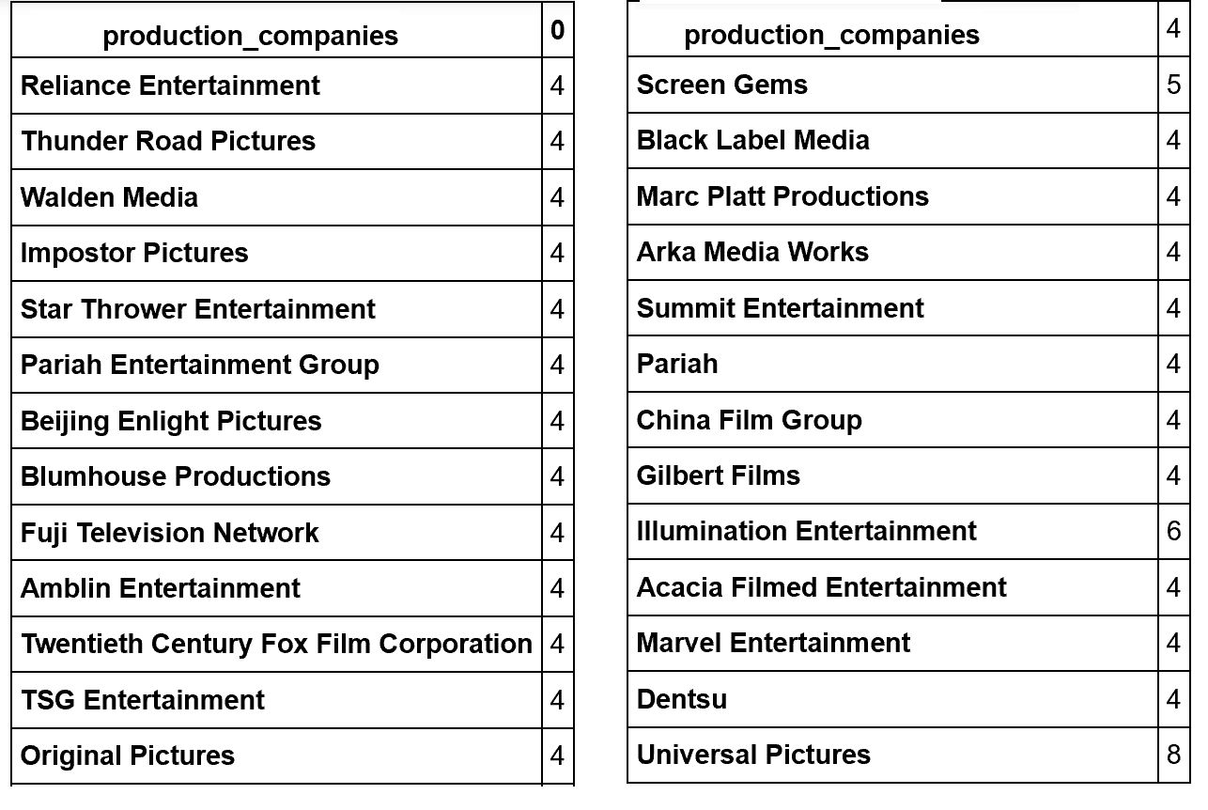
production company that produce the top 10% revenue/budget ratio for more than 3 genres show higher average revenue/budget ratio than the population of all other production companies. (1/2)
Identify production companies that produce the top 10% revenue/budget ratio for more than 3 genres.
Apparently only 26 companies cross the threshold. We can also see that Universal Pictures gain the top revenue/budget ratio for 8 genre out of 20.
Notes:
The list of companies that have high chance to produce profitable movies. Universal pictures again with 8 genres

Slide 14
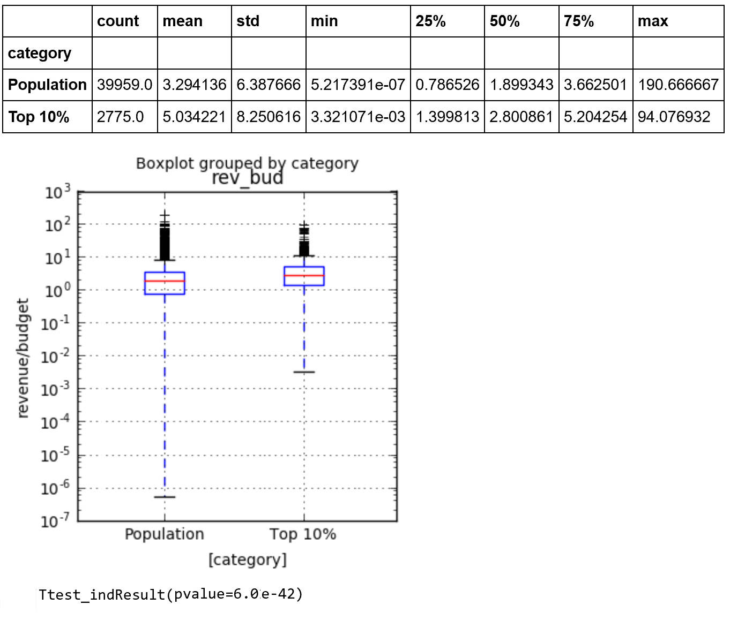
production company that produce the top 10% revenue/budget ratio for more than 3 genres show higher average revenue/budget ratio than the population of all other production companies. (1/2)
What is the average and distribution revenue/budget ratio for the top production companies? Mean 5 Std 8.2
What is the population average and distribution revenue/budget ratio? Mean 3.3 Std 6.4
Performing t-test reveal that we can reject the null. And accept the alternative hypothesis. p<0.05
The top 10% revenue/budget ratio for more than 3 genres show higher average revenue/budget ratio than the population
Notes:
Statistical test show the difference is significant

Slide 15
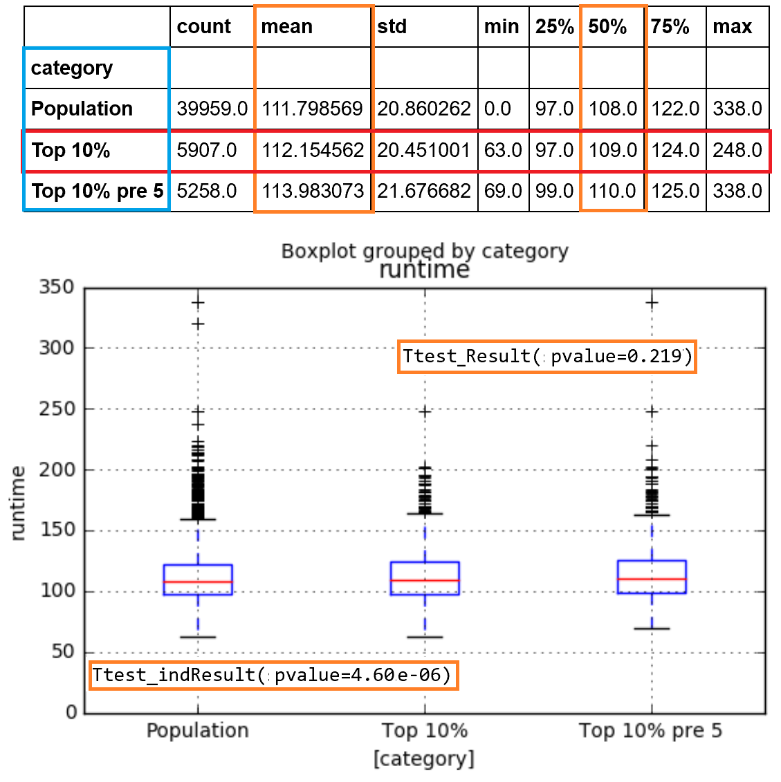
Hypothesis : The average Runtime for movies in the top 10% revenue/budget ratio is different than the population average Runtime.
What is the average Runtime for movies in the top 10% revenue/budget ratio? Mean 112 Std 21
Does the average Runtime for top 10% revenue/budget ratio in the last 5 years is different than the same average in the previous 5 years? Yes Mean 113 Std 21. However the t-test reveal that this difference is not significance p>0.05.
Does the average Runtime for top 10% revenue/budget ratio in the last 5 years is longer or shorter than population average Runtime? Yes Mean 111.8 Std 21. In this case we find that the p<0.05 therefore the observed difference is significant.
Notes:
The difference between the population and the top is significance. The difference between the last 5 years and the previous 5 years is not significant. In any case the difference is only few minutes. It is worth to examine long and short movies statistics.

Slide 16
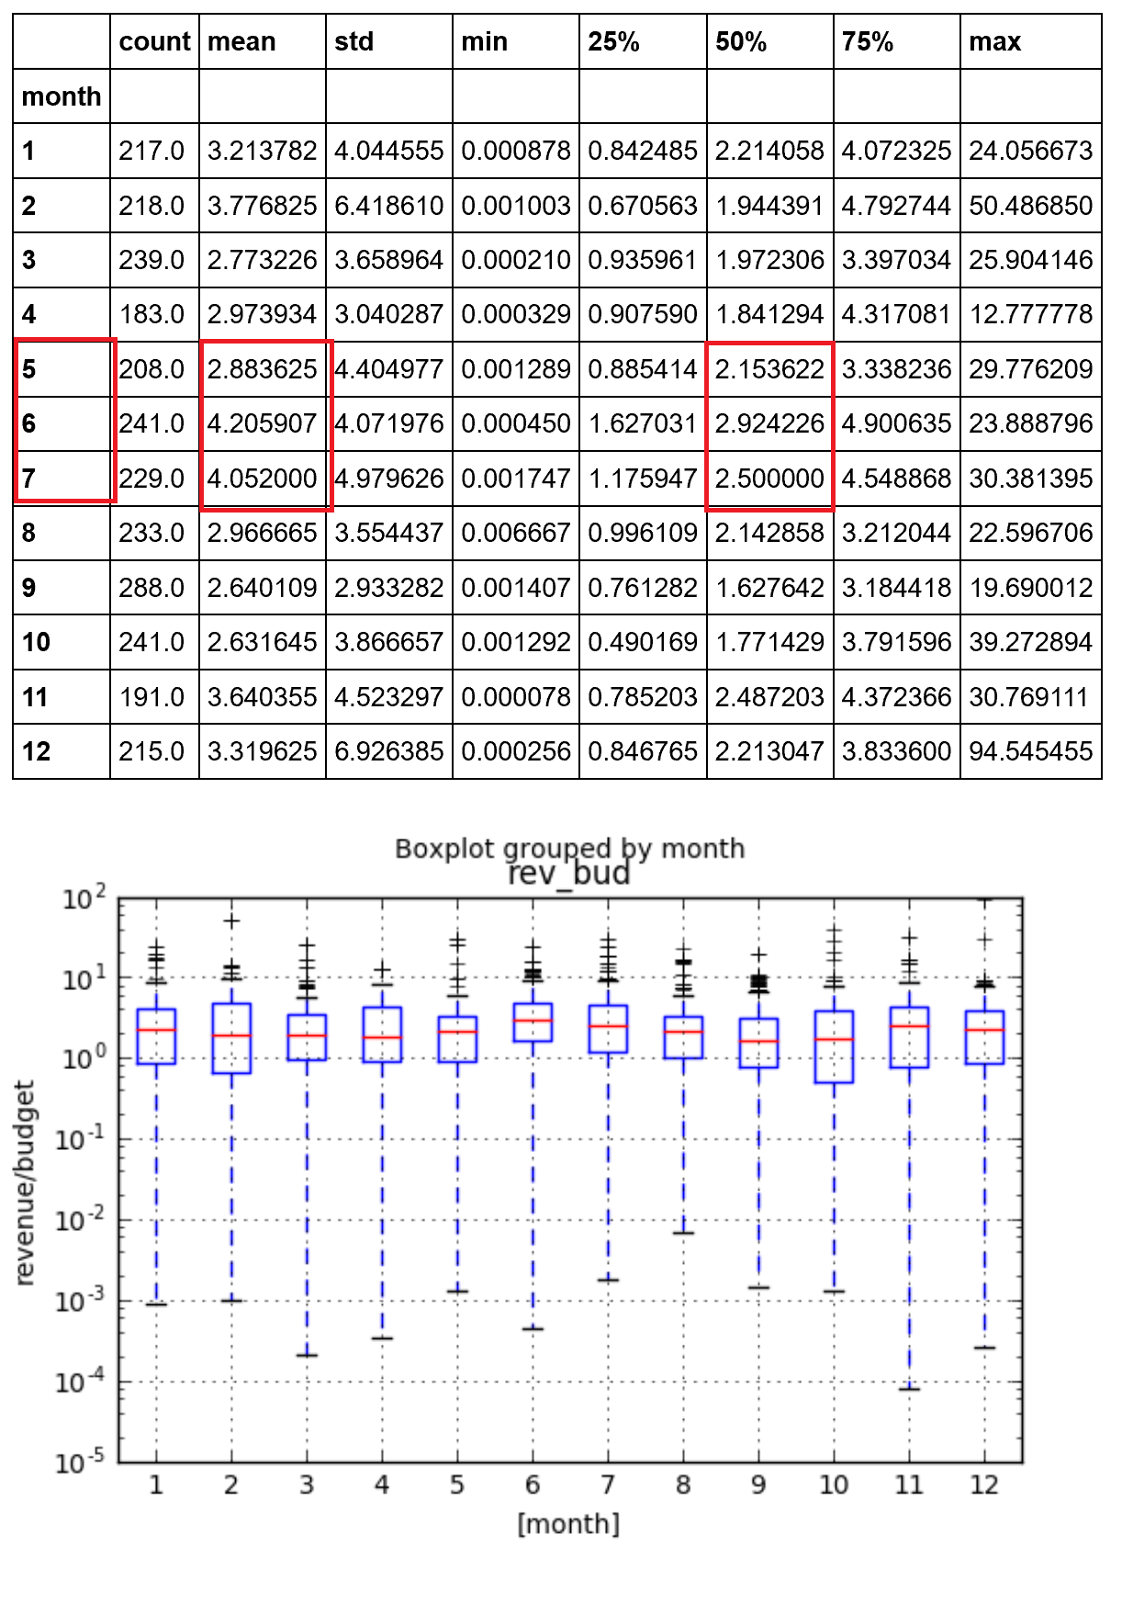
Hypothesis : The average top 10% revenue/budget ratio in the high season is higher than the top 10% revenue/budget ratio yearly average. (1/3)
high season last 5 years
Identify the high season (specific month) that is associated with highest revenue/budget ratio.
We found that month May-July show higher revenue/budget ratio compare to other month.
Notes:
We can see a peak in revenue/budget ratio between May-July

Slide 17
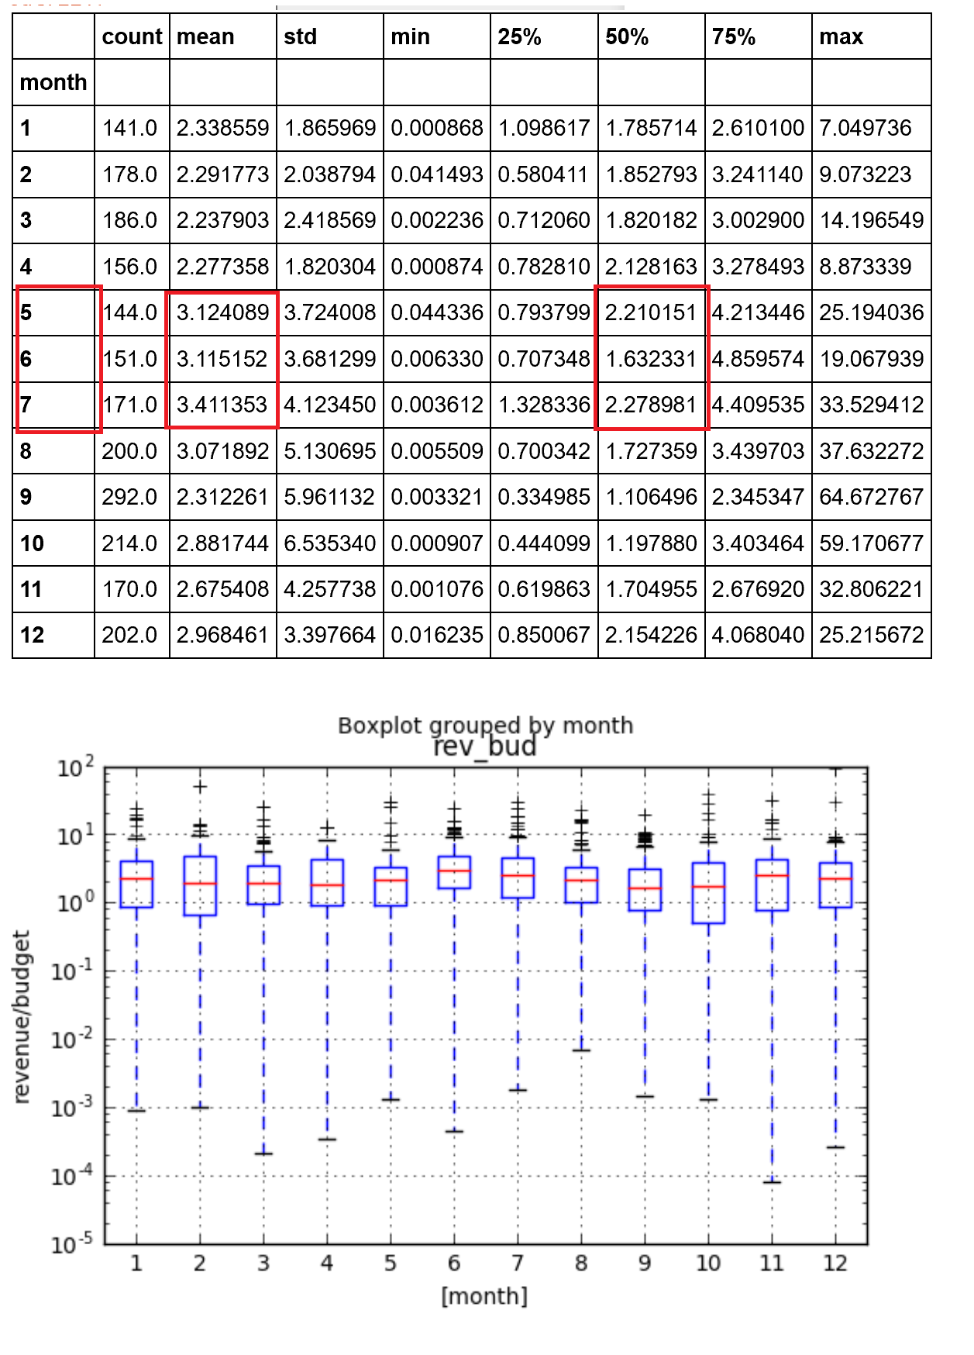
Hypothesis : The average top 10% revenue/budget ratio in the high season is higher than the top 10% revenue/budget ratio yearly average. (2/3)
high season previous 5 years
Does the high season in the last 5 years is different than the high season in the previous 5 years? It seems that the results in the previous 5 years are similar. Month May-July show higher revenue/budget ratio compare to other month.
Notes:
Again the same peak in revenue/budget ratio between May-July

Slide 18
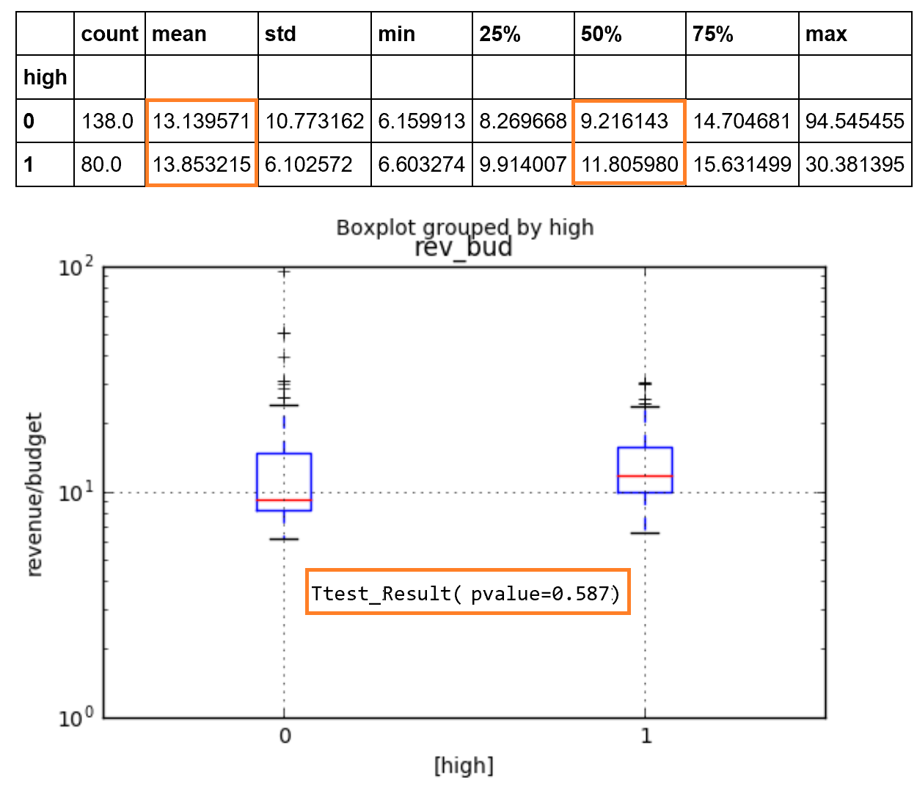
Hypothesis : The average top 10% revenue/budget ratio in the high season is higher than the top 10% revenue/budget ratio yearly average. (3/3)
Does the average top 10% revenue/budget ratio in the high season is higher than the 10% revenue/budget ratio in the rest of the year? We can see that the mean revenue/budget for the high season is Mean 13.8 Std 6, where the other month the Mean 13.1 Std 10. When using a t-test we find that this difference is not significant (p>0.05). This indicates that the high season is not a good indicator for high revenue.
No high season
high season
Notes:
The fact that the result is not significant indicate that there is something here that we should further explore

Slide 19
Summary
Top Production Companies: We identify 20 companies that listed as the top 10% when considering the revenue/budget ratio. Among this 20 companies we identify 2 companies that are listed in 6 and 8 different genres. When comparing the revenue/budget ratio from all the movies produced by these companies to the population of companies we find that these companies show significant higher revenue/budget ratio compare to the population.
Runtime since the difference between the average and the top 10% is not significant we learn that small the runtime does not affect the revenue/budget ratio Interestingly production companies reduce the runtime in the last 5 years. That is probably a good way to cut expenses without affecting the results. Please note that the difference even significance is very small.
The revenue/budget ratio did not show any significant change when comparing the High season to the rest of the year.
Notes:
Important to emphasis the top 2 companies also here.
Run time is not a good indicator for success. Most companies create movies at similar range.

Slide 20
Next step
We recommend to choose one of the top 20 companies that were identify in the analysis to focus the investment of future movies.
We recommend to focus the movie runtime within the narrow range that the analysis identify.
The high season peak even exist in both last and previous 5 years is not significant.

